Slide 1
Experience, Integrity, Innovation
Capabilities Presentation
”Experience, Integrity, and
Innovation”
2023

Slide 2
Experience, Integrity, Innovation
Corporate Leadership
Mr. Fred Casillas
Mr. Casillas, an Army veteran, founded Adjuvant in 2005 with the idea of providing experience, integrity, and innovation to his customers in the federal government. He leads a senior staff rich in experience and knowledge of our customers and workforce management. He has been leading and challenging the workforce to strive to use their technical experience, high integrity, and infuse innovation in their everyday service to their customers.
Mr. T. Nick Meyer
T. Nick Meyer has over 25 years of experience in the federal government sector relating to training and information technology. Mr. Meyer has leveraged his experience to drive Adjuvant toward growth and development. In his role as President of Operations, Mr. Meyer oversees programs, proposals, contracts, financials and business development. Under his leadership, Adjuvant has experienced growth that has exceeded the goals and objectives of the company and unparalleled employee satisfaction.
Mr. Joe Villalobos
Mr. Villalobos, a Marine Corp Veteran, has been working with employers for more than 22 years to find the very best employees for their companies. Mr. Villalobos’ experienced recruiters, extensive screening processes and temp-to-hire arrangements help our client companies avoid expensive hiring mistakes. Mr. Villalobos place employees in a wide variety of office positions, including clerical, administration, and accounting but specializes in Information Technology Placement.

Slide 3
Experience, Integrity, Innovation
Corporate Summary
Business name: Adjuvant Consulting Inc
Address: 17 Kings Heath, San Antonio TX 78257
CEO & Owner: Fred Casillas
Point of contact: T. Nick Meyer, President of Operations
Telephone number: 210-882-6364
Cage code: 324Z5
Size and socio-economic designations: Small Business & SDVOB
Registered NAICS codes: 541511, 541512, 541513, 541519:
Facility clearance status: Secret
Previous STARS II IDIQ Holder – Successfully Completed All Contracts
Over 14m in revenue since 2013 on this vehicle
STARS III IDIQ Holder through the VOICE Joint Venture

Slide 4
Experience, Integrity, Innovation
Corporate Summary
Founded in 2005 based on the values of Experience, Integrity, and Innovation
Successfully Graduated 8(a) July of 2016
Veteran Administration certified Service Disabled Veteran Owned Business (SDVOSB), 2010
Primary NAICS codes
541511: Custom Computer Programming
541512: Computer Systems Design
541513: Facilities support services, computer systems or data processing
541519: Other computer related services
DUNS: 168458110
ESC19 – Awarded a Consulting, Contracted Services, Staff Development & Related (Supplemental) – ESC Region 19 Allied States Cooperative
Certified Histrionically Underutilized Business (HUB)
Certificate/VID Number 1202687642000

Slide 5
Experience, Integrity, Innovation
IT Profile
IT Services and Solutions Provider
Network/Exchange Administration and Configuration/Asset Management
Internet Applications Development
Enterprise Architecture
Application cloud migration
Network Systems/Security Administration
System Analysis, Systems Integration, Programming, and Quality Assurance
Customer Support and Help Desk
Database Architecture/ Data warehouse
Information Assurance/Cyber Security
Training and Conference Support
AV and VTC Development and Maintenance
Program Management – Agile SCRUM

Slide 6
Experience, Integrity, Innovation
Resources Services (Staffing)
Division Leadership
Adjuvant Resources Services is led by Mr. Joe Villalobos who has been working with local employers for more than 20 years to find the very best employees for their companies. Mr. Villalobos’ experienced recruiters, extensive screening processes and temp-to-hire arrangements help our client companies avoid expensive hiring mistakes. In San Antonio, we place employees in a wide variety of office positions, including clerical, administration and accounting but specialize in Information Technology Placement.
Some of our client companies just need temporary help for a variety of reasons. With our large, active, and up-to-date database of candidates looking for employment opportunities, we can help. Because of our network of contacts in the local market, we can also help fill more senior professional positions by direct hire. Hiring new people for your business is difficult and takes time. Learn more about how our experience, resources and staff can assist you by contacting Mr. Villalobos at joe.villalobos@aci-sdvob.com or Mr. Freddie Casillas at FACjr@aci-sdvob.com
Adjuvant is proud to offer a comprehensive workforce services and solution. We are also honored to be a major contributor to the San Antonio business community. In fact, Mr. Villalobos has helped more than 500 local employers find well-qualified temporary and full-time employees and has placed more than 4,000 people into great jobs.

Slide 7
Experience, Integrity, Innovation
Program Management
Adjuvant provides Project Oversight to management of Adjuvant contractors and subcontractors to deliver funding control and analysis and resource requirements. We also managed and facilitated the communication plan, risk and timeline for the program.
Is accountable to executive sponsors for schedule, budget, and quality of all program elements.
Leads high-level sessions for program plan and schedule development.
Reviews/approves project plans for conformance to program strategy and program plan and schedule.
Acts as the communications conduit to stakeholders and program steering committee and conducts periodic briefings/status updates.
On site management, adequate resources, and appropriate authority.

Slide 8
Experience, Integrity, Innovation
Application Cloud Migration
Adjuvant has expertise with both project and portfolio architecture
Amazon Web Services
Certified Solutions Architect on staff
Certified Enterprise Architect on staff
Setup and management of instances in GovCloud
Implementation of DevOps in cloud
Application migrated both rehosting and refactoring with native cloud services
Data can be leverage for application rationalization

Slide 9
Experience, Integrity, Innovation
AWS Optimization Phase I
Adjuvant completed Phase I of AWS Support to Sports Thread. Sports Thread is a platform that allows athletes to showcase their stats, measurables, film, and more to continue your athletic careers. It allows athletes to connect with others to learn and share in the victories and defeats of being a student-athlete.
With Adjuvant’s support of providing a plan for AWS Optimization, the Sports Thread’s platform now features an API that pulls in data from existing colleges as well as mechanisms for Sports Thread to pull in various information beneficial to the athlete. Finally, this support resulted in maximizing the optimization for a staging environment which has been critical as the Sports Threat Platform continues to grow.

Slide 10
Experience, Integrity, Innovation
Enterprise Architecture
Adjuvant has expertise with both project and portfolio architecture
Department of Defense Architecture Framework (DoDAF)
Service views and Operational Views
Business processing modeling notation
Enterprise encyclopedia with software descriptions
Data can be leverage for application rationalization

Slide 11
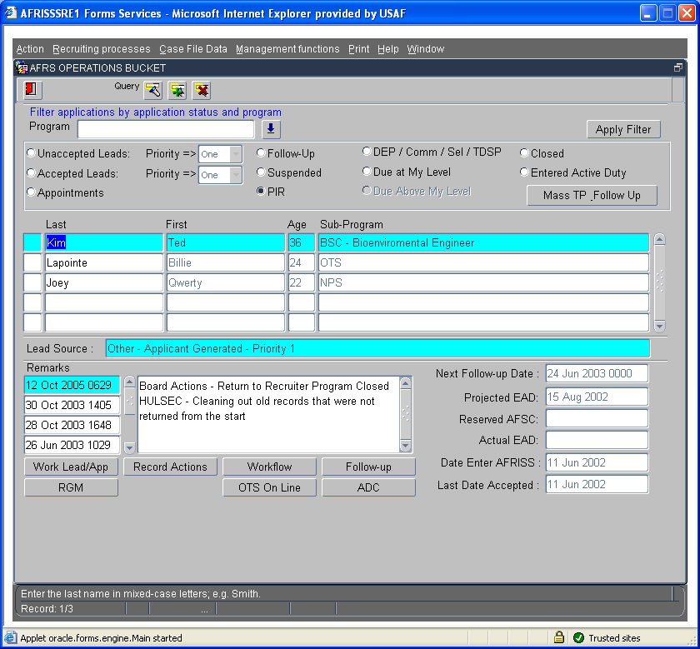
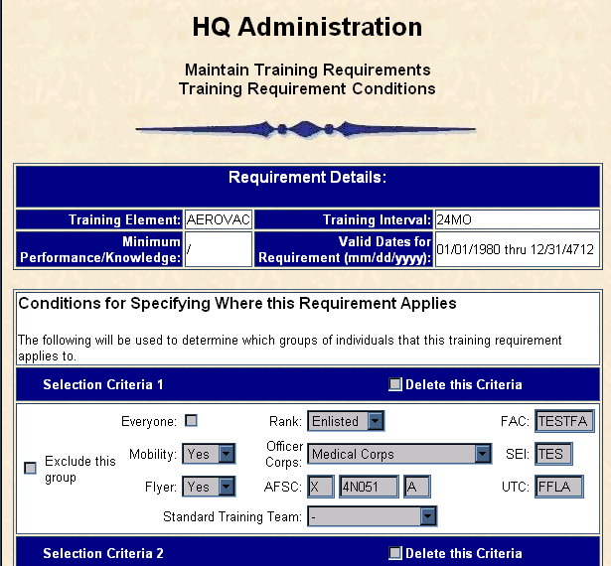
Experience, Integrity, Innovation
Application Technologies
Internet Enabled System Development
Cross-Platform Web System Design and Development
Application Interface Development utilizing
JAVA, J2EE
ASP.NET, NodeJS, XML, UML, HTML5, ReactJS
Visual Basic and C#
Certified Scrum Master on staff

Slide 12
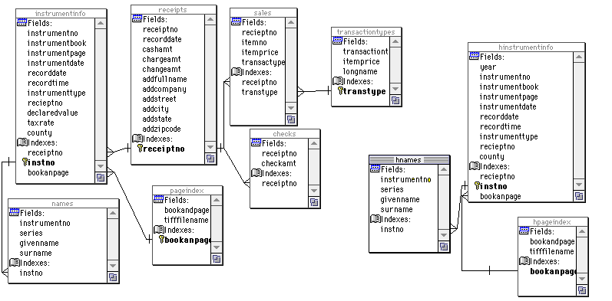
Experience, Integrity, Innovation
Database Competencies
Database Architecture Design
Logical layer
Physical layer
Database Development & Implementation
Online Transaction Processing (OLTP)
Online Analytical Processing (OLAP)
Database Administration
ORACLE, SQL*Server & others
Data Migration
Production operations
Performance Tuning
Security
Disaster Recovery

Slide 13
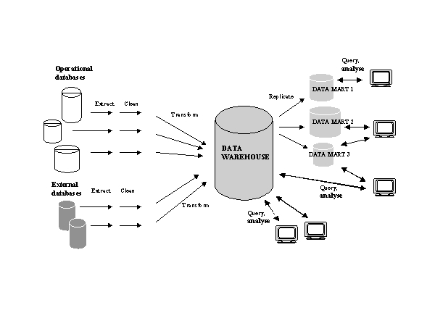
Experience, Integrity, Innovation
Data Warehousing / Business Intelligence
Data Homogenization from Multiple Sources
Extract
Transformation and Cleansing
Loading
Desktop and Web-Based Analysis and Reporting
ORACLE Discoverer
Business Objects
Others

Slide 14
Experience, Integrity, Innovation
Network, Helpdesk, Information Assurance, and Equipment Custodian Support
Network Support
IT policy implementation
Network Administration
Exchange Server Administration
Network Security Administration
Helpdesk Support
Multiple Applications support with over 18,000 calls per year
Equipment Custodian
Equipment Custodian Support of assets valued over 18m

Slide 15
Experience, Integrity, Innovation
Systems Support
Unix Administration
System Build outs
Kernel configurations
Administration
Windows Administration
Operations, development, deployment, and applications support
Microsoft Windows Server and related server technologies
Security, software distribution and management,
TCP/IP, Active Directory, Domain Name Service (DNS)
Windows Internet Naming Service (WINS)
Remote Desktop, browsers, backup and recovery,
Desktop and server environments (multi-user, multi-architecture)
Multi-site configuration, security protocols such as Secure Sockets Layer (SSL)
Secure File Transfer Protocol (SFTP), PGP, DoD Public Key Infrastructure (PKI)
Kerberos and some Hypertext Markup Language (HTML)

Slide 16
Experience, Integrity, Innovation
Past Performance – HRSTS eBoss Project
Overview: Adjuvant currently provides the Chief Solutions Architect and software development to the AFLCMC/HIH eBoss project which consists of over 50 personnel. This project Provides Total Force electronic board application and graphical user interface (GUI) to present a like experience for retrieval, viewing, and scoring of all board operations and development team events. It accommodates individual ergonomic and administrative preferences through touch surfaces, dual screens, portable workstations, and wireless technology.
Microsoft is phasing out support to Silverlight as the web transitions off browser plug-ins. The government is transitioning from On-premises to a cloud-based infrastructure. Electronic Board Operations Support System (eBOSS) is part of a portfolio targeting the use of Amazon Web Services (AWS) cloud. Our team is tasked to achieve the technical mandates mentioned above and to implement this upgrade using Agile and DevOps for this USAF promotions systems. The team modified the front-end technology, streamlined the user interface, and re-wrote middle tier bottlenecks. This effort uses Agile methodology and DevOps pipeline leveraging native cloud services..
Technology Stack: Our team targeted cutting-edge technologies to support the upgrade for optimization of performance in a cloud environment. Cutting edge technologies used include: AWS CloudFormation to provision our environments and third-party tools. AWS Beanstalk is implemented to handle deployments and auto-scaling of Java and Node.JS applications. AWS CloudWatch alarms setup for monitoring cloud resources, applications, and services. React, Redux are the front-end technologies to provide a rich user interface to run on any browser. Jenkins being utilized to automate builds and manage our DevOps pipeline.

Slide 17
Experience, Integrity, Innovation
Past Performance – Medical IT / Health care Systems Support services:
Navy Health Care Clinic, Charleston, NC
Adjuvant currently provides IT support and services to the Naval Health Clinic Charleston (NHCC) which provides medical care to active duty, retired and dependents of all branches of military service.
Under our support NHCC has become a fully accredited and certified clinic utilizing the latest in computer related diagnostic and reporting techniques.
Adjuvant provides support in the following areas Program Management Services, Computer workstations: Hardware/Software Maintenance Services, Help Desk Operational Support, Inventory Management, LAN Maintenance and Telecommunications Support, Health Information and Data Collection, Training, Computer Operations Support, Administrative Support, Medical Data Analysis, System Security.

Slide 18
Experience, Integrity, Innovation
Past Performance – Financial Application Technology & CSA Support
Air Combat Command FSA Support
In support of Air Combat Command (ACC) Host Base Comptroller Squadrons Financial Management (FM) Adjuvant currently provides information technology support for computer operations, LAN component and PC installation, network configuration and troubleshooting to assure uninterrupted accomplishment of daily operations and long-term system viability.
This support extends to several ACC bases including ACC Host Base Comptroller Squadrons at the following installations; Beale AFB CA, Davis-Monthan AFB AZ, Dyess AFB TX, Holloman AFB NM, Moody AFB GA, Mountain Home AFB ID, Nellis AFB NV, Offutt AFB NE, Seymour-Johnson AFB NC, and Shaw AFB SC.
Adjuvant’s FSA support for this contract is split into two primary areas – basic computer systems administration and financial systems application administration. Our team ensures that 1) the customers’ financial systems integration and network connectivity to local Network Operation Support Centers (NOSC’s) and Defense Mega Centers (DMCs) is working and 2) our team provides the required level of oversight, maintenance, and administrative support to ensure uninterrupted accomplishment of daily financial operations

Slide 19
Experience, Integrity, Innovation
Past Performance – DISA PKI Application Technology Support
DISA Defense Enterprise Computer Center (DECC)
Implementation and Maintenance Logistics (ILM32) requirement for Public Key Infrastructure (PKI), Mission Assurance Category Level 1 (MAC 1) Application, Mid-tier and Small System Integration, Network and Operations Support at Defense Enterprise Computing Center (DECC) Mechanicsburg PA. Specific areas of support include 6 tasks:
Task 1) Development and Integration of Software Programs to include systems administration for 70 Linux boxes.
Task 2) Efficiency Recommendations for Mid-Tier and Server Based Systems,
Task 3) Computing Services Troubleshooting,
Task 4) Software Maintenance Support,
Task 5) Network Architecture Support, and
Task 6) Contract Management

Slide 20
Experience, Integrity, Innovation
Past Performance - Software
Recruiting Service (Air Force)
Analysis/application development, data warehouse, and web site support in the maintenance and operational functionality
Network/exchange oversight and administration and e-mail configuration management
Network systems/security administration, IT policy implementation
System analysis, engineering, systems integration, programming and Quality Assurance
Develop process models
Standardized logical and physical data models
Maintain Data communications (Interface oversight)
Personnel Data Systems,
US Military Entrance Processing Command (US MEPCOM) systems,
Military Entrance Processing Station (MEPS) systems,
Military Personnel Data System (MILPDS) systems.
SOA Support
Customer Support, Equipment Custodian/ADPE and Help Desk.
Veterans Administration (Austin)
ORACLE software development support
ORACLE Designer & ORACLE version 9i
Cobol development and sustainment support
Senior Leadership Management System (Air Force)
Develop and input data for the system for a multi-user, WEB-based, client-server system
Basic training in the function of the new system for all users to explain concept, flow and general usage and navigation.

Slide 21
Experience, Integrity, Innovation
Past Performance - Network
Intelligence and Space Command (Air Force)
Network administration management
Network systems/security administration
Problem Resolution using REMEDY and HEAT
Install or replace desktop workstations including setup of new systems to SDC standards
Plans and Programs (Air Force)
Network administration management
Network systems/security administration
Problem Resolution using REMEDY and HEAT
Install or replace desktop workstations including setup of new systems to SDC standards
SharePoint and SQL Server Administration
Occupational Measurement Squadron (Air Force)
Network administration management
Network systems/security administration
12th Comptrollers Squadron & Headquarters Support (Air Force)
Network administration management
Network systems/security administration
Veterans Administration:
Application and Helpdesk Support as well as Software Development

Slide 22
Experience, Integrity, Innovation
Past Performance - Program Management
Combat Systems Officer Program Management and Training Requirements Determination (Air Force)
PM oversight and support of 78.4M acquisition program to deliver 42 Modified aircrafts, 34 Aircraft Simulators for aircraft modified with the new aircrew life support system.
On-site analysis and assessment through the use of qualitative and/or quantitative methods was used to build upon and improve current AETC CSO plans and programs.
Provided funding profiles and system acquisition. Interface via the Adjuvant Program Manager occurred between Adjuvant CSO contract support and 19th Air Force, other USAF major commands the Navy, and other relevant acquisition program offices.
Developed accurate and timely program funding estimates, revised/updated current funding estimates and analysis of impacts associated with any funding cuts.
Developed and updated acquisition requirements and capabilities documents.
Coordination/Staffing and Presentation of CSO requirements
Assembly/Analysis of Facts to Establish Trends and Recommend Solutions.
The support services provided enabled the design, development and scheduled delivery of both a modified T-1A aircraft and the T25 Simulator for new training.

Slide 23
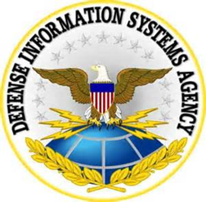
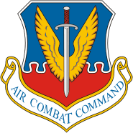
Experience, Integrity, Innovation
Customers:

Slide 24
Experience, Integrity, Innovation
Customer Locations:
DISA
ACC
Navy
AETC
AFPC
AFRS
24

Slide 25
Experience, Integrity, Innovation
Customer Locations:
DISA
ACC
Navy
ACC Locations:
Langley AFB
Mountain Home AFB
Offutt AFB
Seymour-Johnson AFB
Shaw AFB
Moody AFB
Beale AFB
Davis-Monthan AFB
Hollaman AFB
Nellis AFB
AETC
AFPC
AFRS
25

Slide 26
Experience, Integrity, Innovation
Selected business partners with similar corporate goals and values:
Software Engineering Services (SES)
Isobar
DTSI
NCI
Lockheed Martin
Innove
American Systems

Slide 27
Experience, Integrity, Innovation
Adjuvant Value:
Advanced technology base
Flexibility/Adaptability to Customer’s Needs
Quality standards to include Quality Control Plans
Responsiveness
Reduced Risk
Competitive Pricing
LPTA and SCA Contract wins with successful execution
IDIQs contract vehicles:
GSA 8a STARS III – Joint Venture (Prime) Awarded Dec 2021
GSA – Multiple Award Schedule (Schedule 70)
518210C
54151HEAL
54151S
OLM
SDVOSB certified company
ESCRegion 19 contract access
Texas HUB Certified

Slide 28
Experience, Integrity, Innovation
Summary
Technology based services company
Founded in 2005
SDVOB VA certified company in 2010
GSA 8a successful graduate 2016
Staff Retention Rate above 85% since 2005
Outstanding CPARS Ratings (Cage Code 324Z5)
3.8m dollar average annual revenue
Controlled Growth continues to climb
Infrastructure commensurate with employee growth
Centralized management, decentralized operations
Quality Service at Competitive Prices

Slide 29
Experience, Integrity, Innovation
Points of Contact:
ADJUVANT CONSULTING INC (ACI)
17 Kings Heath San Antonio, Texas 78257 210.829.8560 210.417.4110 (fax) www.ACI-SDVOB.com
Fred Casillas T. Nick Meyer
President and Owner President of Operations
210.829.8560 Office 210.829.8560 Office
Fred.Casillas@aci-sdvob.com 210.882.6364 Cell Phone TNick.Meyer@aci-sdvob.com
Joe Villalobos
Director of Professional Staffing Services
210.771.5058
Joe.Villalobos@aci-sdvob.com

Slide 30
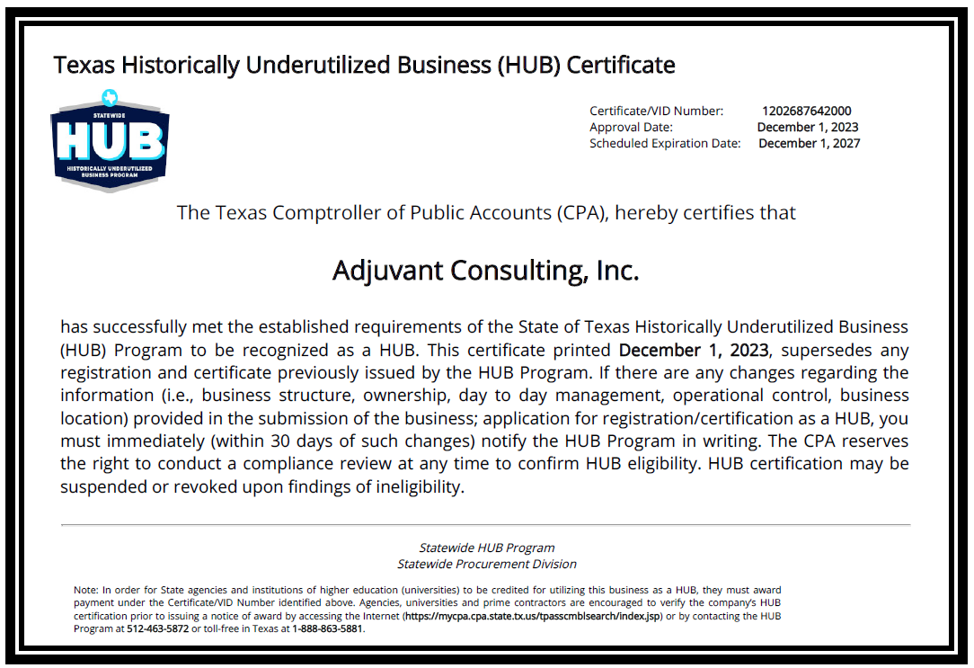
Adjuvant’s Texas HUB Certificate

Slide 31
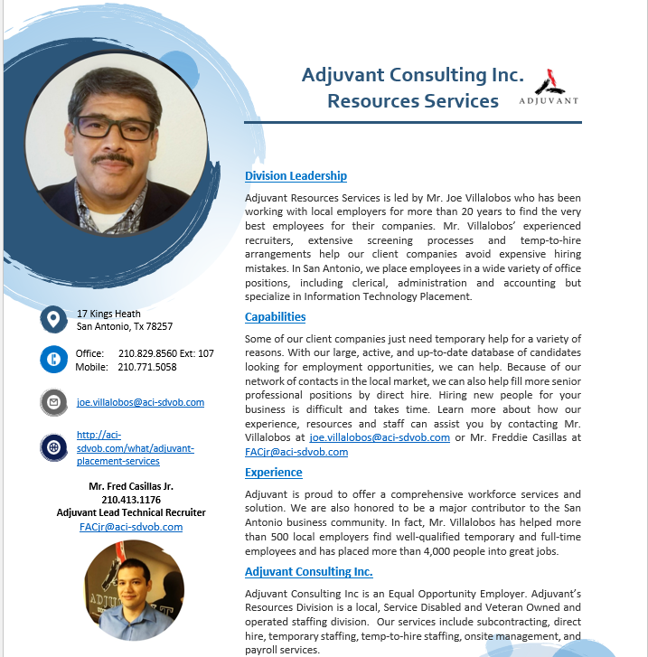

Slide 32
